Slide 1
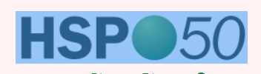
High-efficient and automatic determination of Hansen Solubility (dispersibility) parameters of micro-, nano-particles and quantum dots by instrumental in-situ visualization and quantification of sedimentation behavior under normal or high gravity.
Dietmar Lerche, LUM GmbH, Berlin, Germany

Slide 2
First of all:
It´s not only me; it´s a team work
Many thanks to:
Sebastian Süß
Wolfgang Peukert
Doris Segets
Institute of Particle Technology (LFG), FAU, Erlangen, Germany
Titus Sobisch
Luis Rodriguez
Sonja Horvat
LUM GmbH & Dr. Lerche KG, Berlin, Germany

Slide 3
Introduction
Nano@microparticles are essential to innovative products.
A dispersion or formulation step into a liquid phase is often mandatory.
The liquid/continuous phase must suite the specific requirements, dispersed state of particles should not change over product life time.
Particle and its surrounding liquid have to be adjusted to each other
3

Slide 4
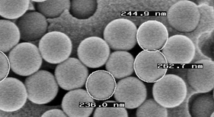
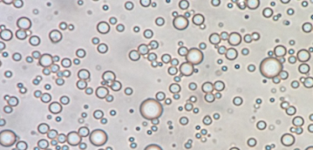
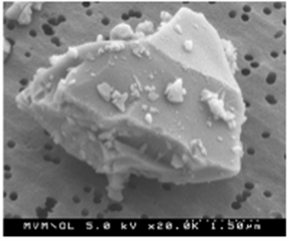
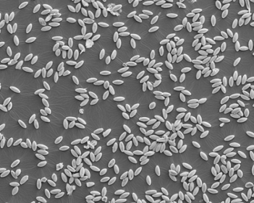
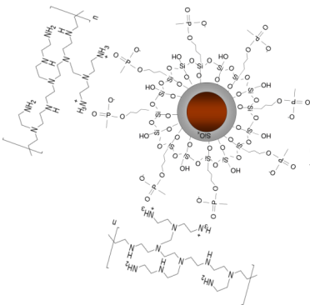
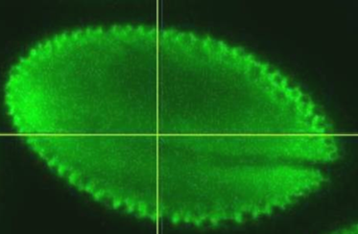
Relevant particles characteristics for dispersion
A. Geometrical characteristics
Size, Size Distribution, Shape
B. Surface characteristics
Surface morphology, chemical composition, ions, surfactance, coating materials (e.g. polymers), pickering particles
Hansen Solubility Parameter
since 50 years
4

Slide 5
How to determine the HSP of particles?
Experimental task:
1. to choose a set of test liquids covering more
or less the 3D-Hansen space (or interested part)
2. to disperse particles into different test liquids
3. to „detect“ the behavior „How suspensed do they stay“
4. to score the observation from 0 to 1
5. to calculate HSP (e.g. HSPiP Software package)

Slide 6

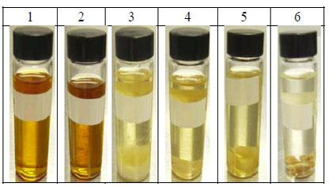
Why does not everyone use the HSP approach?
1. Quantification of particle behavior in liquids/continous phases
C. Hansen introduced quantification as a merit of sedimentation time or velocity
subjective
time consuming for nano
2. Ranking of liquids: Good or Bad
M. Bixenman et al. (2010) Quality control of cleaniless of electronic parts
3. No standardized routine method.

Slide 7
How to determine the HSP of particles?
Experimental task:
1. to choose a set of test liquids covering more
or less the 3D-Hansen space (or interested part)
2. to disperse particles into different test liquids
3. to instrumentally „detect“ the behavior
4. to automatically score the observation from 0 to 1
5. to calculate HSP (e.g. HSPiP Software package)

Slide 8
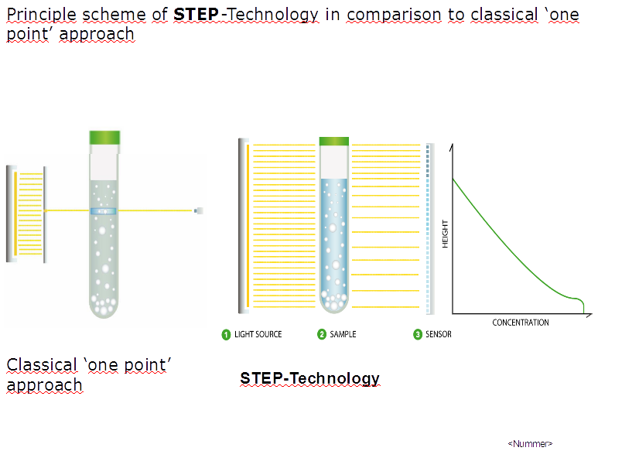



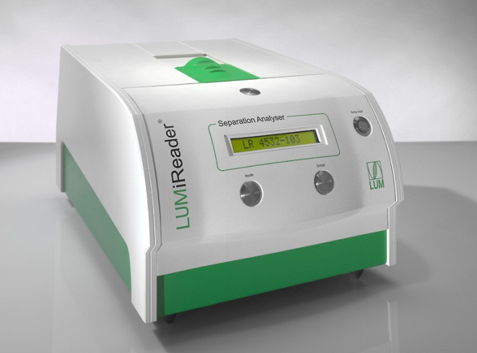
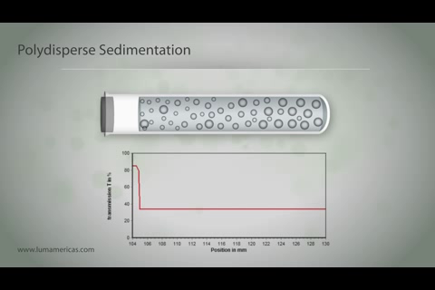
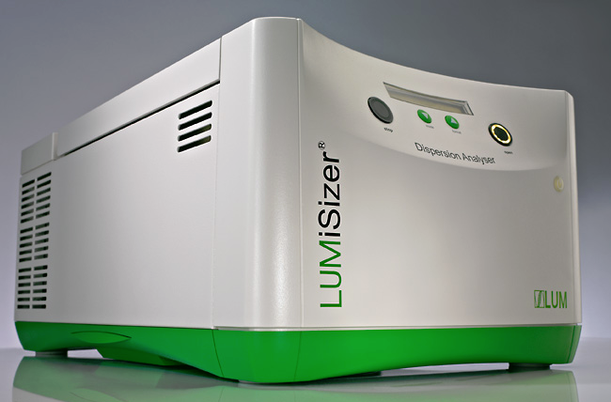
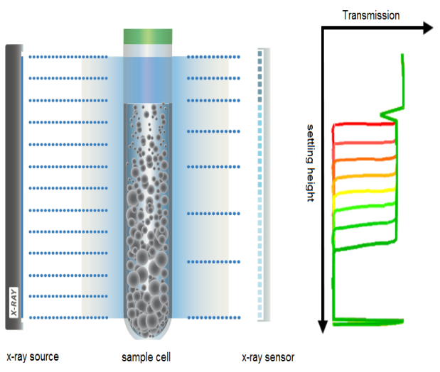
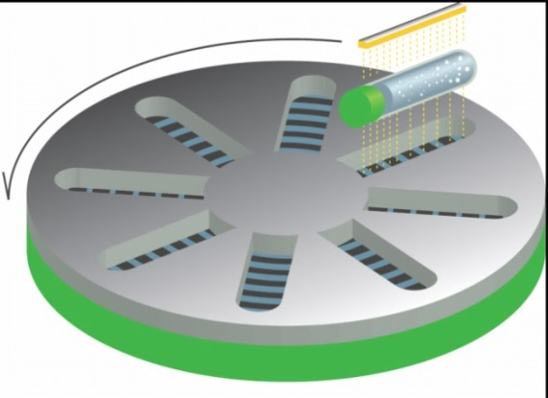
In-situ visualization of dispersion state
by STEP-Technology
Conventional
“one point” techniques
Space and Time resolved
Extinction Profiles
t₁ > t₀
12 channels,
λ = 870, 470 nm
NIR
VL
X-Ray
Animation see:
Youtube channel ‚LUM GmbH‘
Notes:
Aimation in der Mitte anhalten

Slide 9
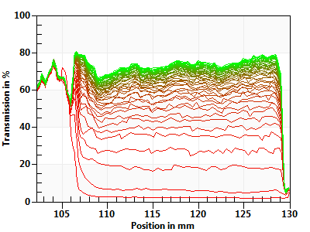
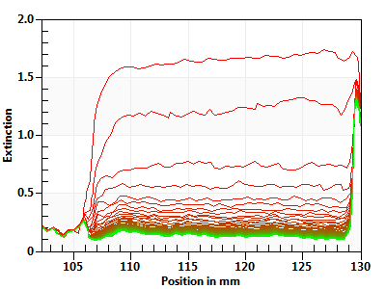
In-situ visualization of particle sedimentation
Transmission:
Extinction/Concentration:
I_{t,p}
I_{t,p}
T_{t,p} =
- lg = E_{t,p} = ε . c_{t,p} . d
I₀
I₀
Meniscus
Bottom
Meniscus
Bottom
last profile
start
start
last profile
LUMiSizer experiments. Visualization and analysis by Software Package SEPView
Notes:
Iolitec 0.05%

Slide 10
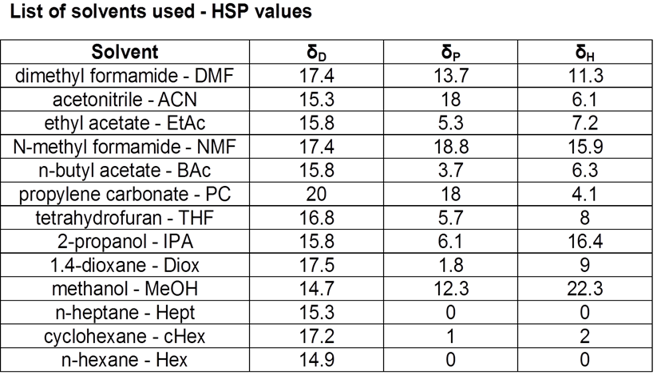
General SOP:
1. Select appropriate continuous phase/liquid
List of liquids used for Finn Talc 15
Liquid
HSPs available from HSPiP

Slide 11
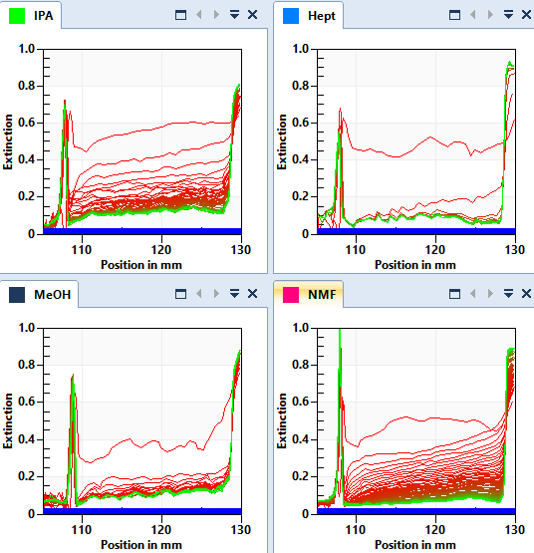
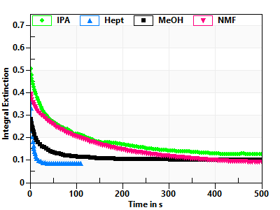
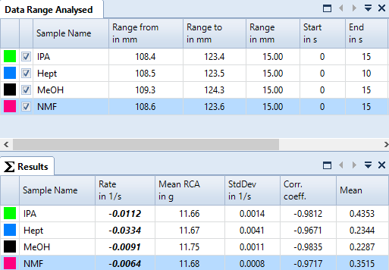
General SOP:
2. Disperse particles into continuous phases,
measure sedimentation at earth or higher gravity
of up to 12 samples simultaneously.
Isopropanol
n-Heptane
LUMiSizer:
Time Interval:
2s to hours 10s
Temperatur:
4 to 25°C
Acceleration
6 to 2300
times earth
gravity
Methanol
N-Methylformamide

Slide 12
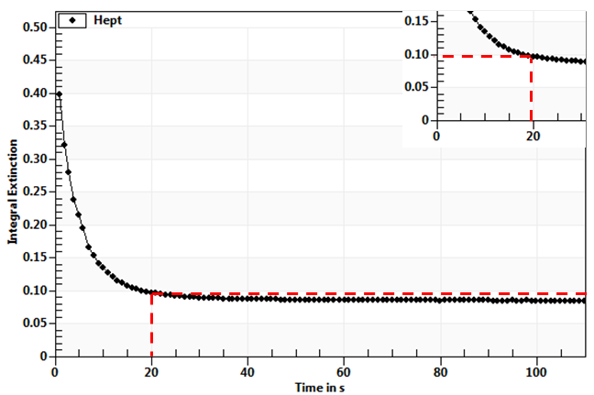
General SOP:
3. Calculate sedimentation time (ST) based on Integral Extinction (IE)
ST = time to
reach
E₀ + 0.15
(or any
appropriate value
according to
sedimentation kinetics)
Sedimentation time
E₀ = extinction of
pure liquid

Slide 13
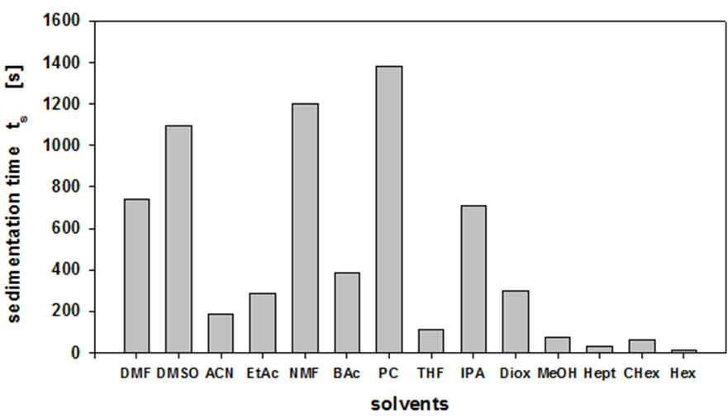
General SOP:
3. Calculate sedimentation time (ST) based on
Integral Extinction (IE)
Absolute ST of Finn Calc dispersed in different liquids

Slide 14
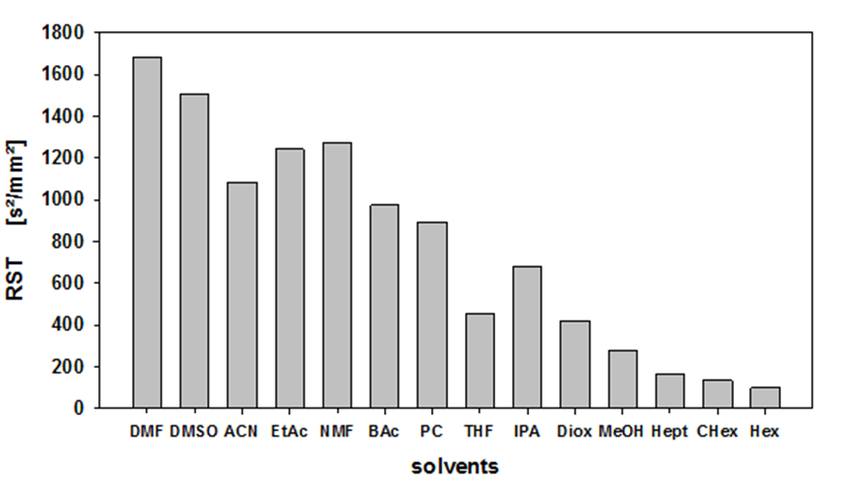
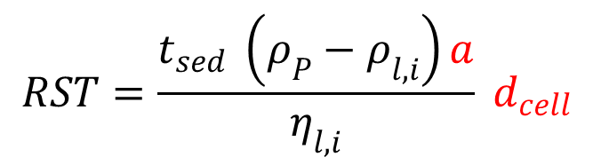
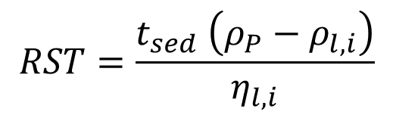
General SOP:
4. Relative sedimentation times RST
Accounts for density &
viscosity differences
$$RST=\frac{t_{sed} \left(ρ_{P}−ρ_{l,i}\right)}{η_{l,i}}$$
Proposed by C. Hansen
liquids
Extention for dimensionless RST
Accounts also for gravity
and optical path
$$RST=\frac{t_{sed} \left(ρ_{P}−ρ_{l,i}\right)a}{η_{l,i}} d_{cell}$$

Slide 15
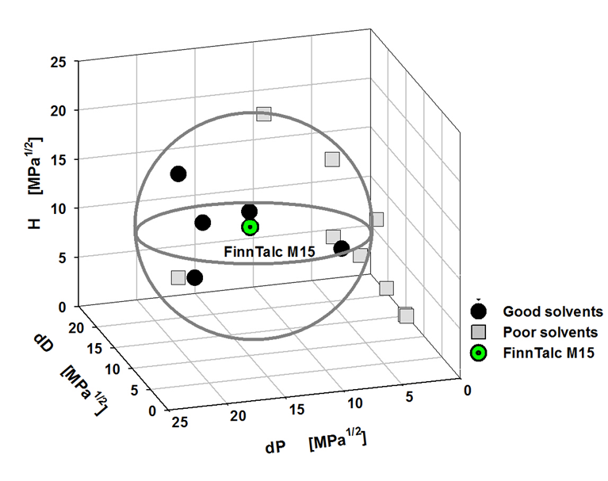
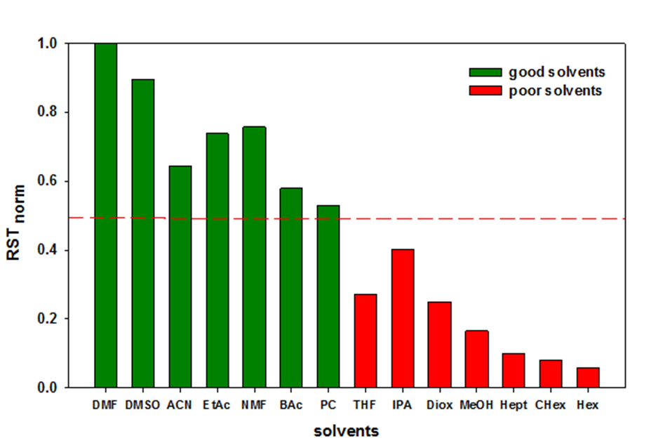
General SOP:
5. Score RST to 0, 1
6. Calculate HSPs
Finn Talc M15
Normalization of RST
Score by rounding
δ_{d} =12.1 MPa^{0.5}; δ_{P} =17.7 MPa^{0.5}
δ_{h} =3.9 MPa^{0.5}; R0 =9.1 MPa^{0.5}
by HSPiP-software, Abbott
Lerche et al., Dispersion Letters 5 (2015) 13 - 18
Süss et al., in preparation
15
Notes:
Good, bad????

Slide 16
Application Carbon Black
List of liquids used for CB study
Liquid | purity / % | purpose | company
1. n-hexane (Hex) | ≥ 95 | screening | C.Roth, Germany
2. triethylamine (TEA) | ≥ 99.5 | screening | C.Roth, Germany
3. p‑xylene (Xyl) | 99 | screening | Sigma-Aldrich, Germany
4. N-methyl-2-pyrrolidone (NMP) | ≥ 99.8 | screening | C.Roth, Germany
5. 1.4-dioxane (Diox) | ≥ 99.5 | screening | C.Roth, Germany
6. ethyl acetate (EA) | > 99.5 | screening | C.Roth, Germany
7. tetrahydrofuran (THF) | ≥ 99.5 | screening | C.Roth, Germany
8. isopropyl alcohol (IPA) | ≥ 99.8 | screening | C.Roth, Germany
9. acetonitrile (ACN) | ≥ 99.5 | screening | C.Roth, Germany
10. N,N-dimethylformamide (DMF) | ≥ 99.5 | screening | C.Roth, Germany
11. dimethyl sulfoxide (DMSO) | ≥ 99.5 | screening | C.Roth, Germany
12. methanol (MeOH) | ≥ 99.9 | screening | C.Roth, Germany
13. 2-butoxyethanol acetate (BAc) | ≥ 98 | screening | Merck, Germany
14. acetone (Act) | ≥ 99.8 | screening | C.Roth, Germany
15. n-pentane (Pent) | ≥ 99 | validation | C.Roth, Germany
16. methyl acetate (MA) | ≥ 99 | validation | C.Roth, Germany
17. dimethyl carbonate (DMC) | ≥ 99.8 | validation | C.Roth, Germany
18. 1.4-butanediol (BD) | ≥ 99 | validation | C.Roth, Germany

Slide 17
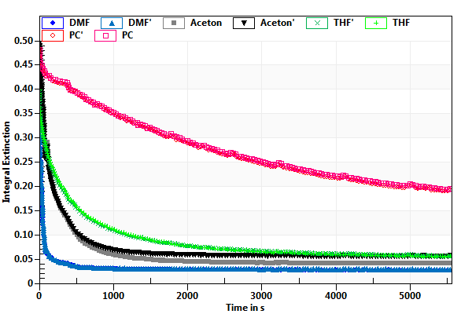
HSP of Carbon black:
Integral extinction in different liquids
Region of IE to
determine RST.
must include
best and
worst solvent.
Integral Extinction (IE) calculated of a ROI of 15 mm below meniscus

Slide 18
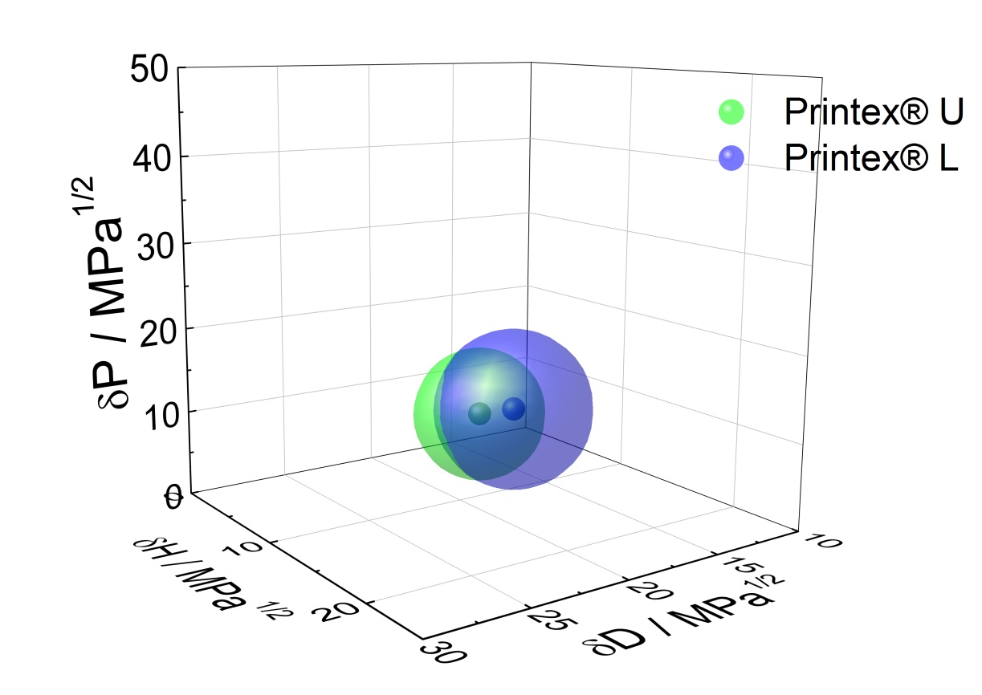
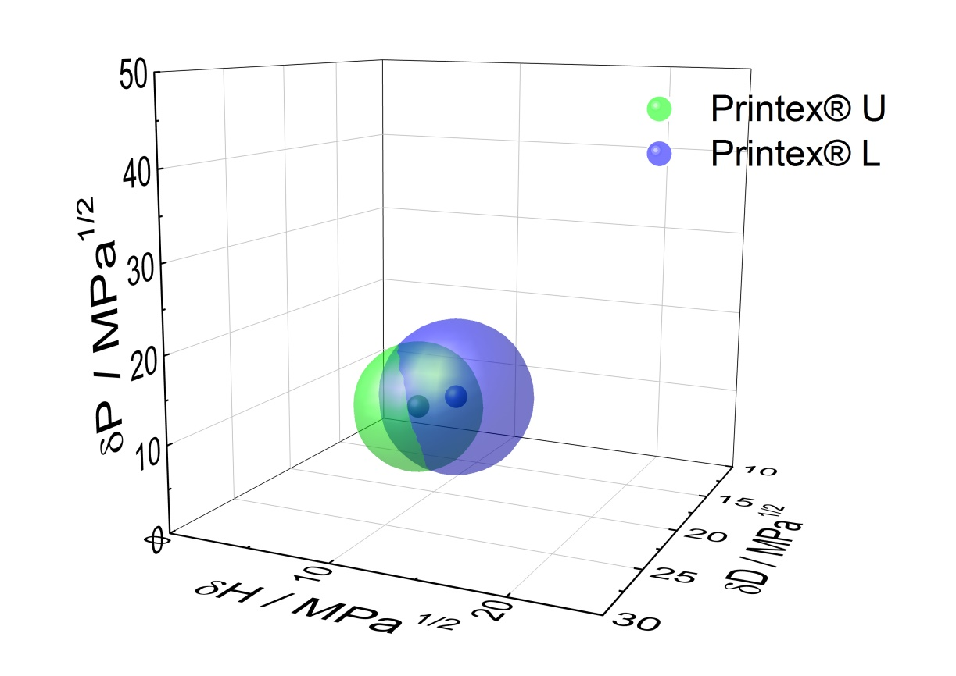
HSPs of Carbon Black
Comparison of Printex® L & Printex® U
Score by
rounding
 | δD / MPa^{0.5} | δP / MPa^{0.5} | δH / MPa^{0.5} | R / MPa^{0.5}
Printex® L | 16.56 | 9.5 | 9.42 | 5
Printex® U | 17.35 | 8.22 | 7.29 | 4.3
HSP in same range, but different due to manufacturing process
Developed approach sensitive to distinguish both products

Slide 19
Processing (energy, time) alters
surface properties of CB
Score by
rounding
15 min sonic bath
1 min sonotrode
10 min sonotrode
D
D
D
15
P
15
P
15
P
H
H
H
HSP
HSP
HSP
10
10
10
5
5
5
0
0
0
1
2
3
1
2
3
1
2
3
Stock concentration of Carbon Black 0.7 g/l,
A: 1. 15 sec Vortex + 15 min US bath, 2. diluted to 0.014 g/l, 3. again 15 min US bath
B: 1. 15 sec Vortex + 5 min US bath, 2. diluted to 0.014 g/l, 3. 1 min US treatment
C: 1. 15 sec Vortex + 5 min US bath, 2. diluted to 0.014 g/l, 3. 10 min US treatment
US treatment: 3 – 4 ml Suspension, IKASONIC U 50, Amplitude 100 %, Cycle 1, Sonotrode 600 W/cm²
Notes:
eventuell 1 min rausnehmen?

Slide 20
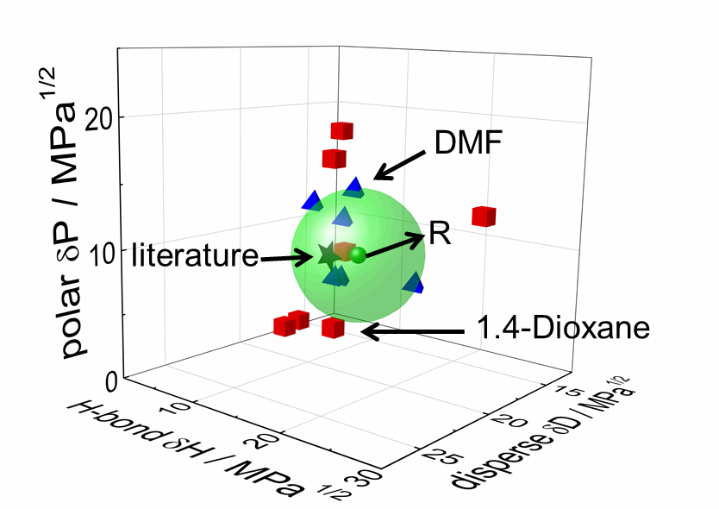
HSP of Carbon black (HSPiP)
(C. Hansen)

Slide 21
Validation of HSP regarding chosen IE and CA
for RST determination

Slide 22
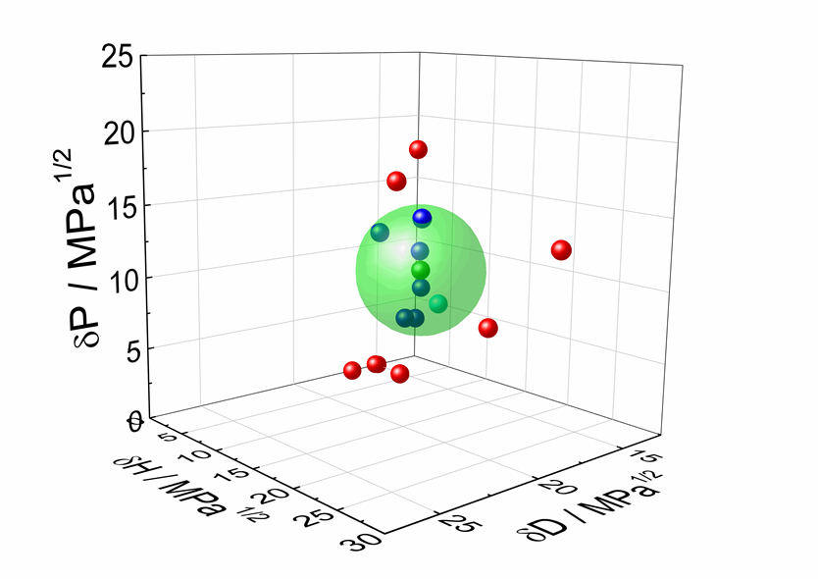
Validation of HSP approach by dispersing into a “good” liquid
Printex® L dispersed
into Diethylene
Glycol Butylether
Expected based on
Liquid HSPs
to be “good”
Solvent is ranked as good solvent

Slide 23
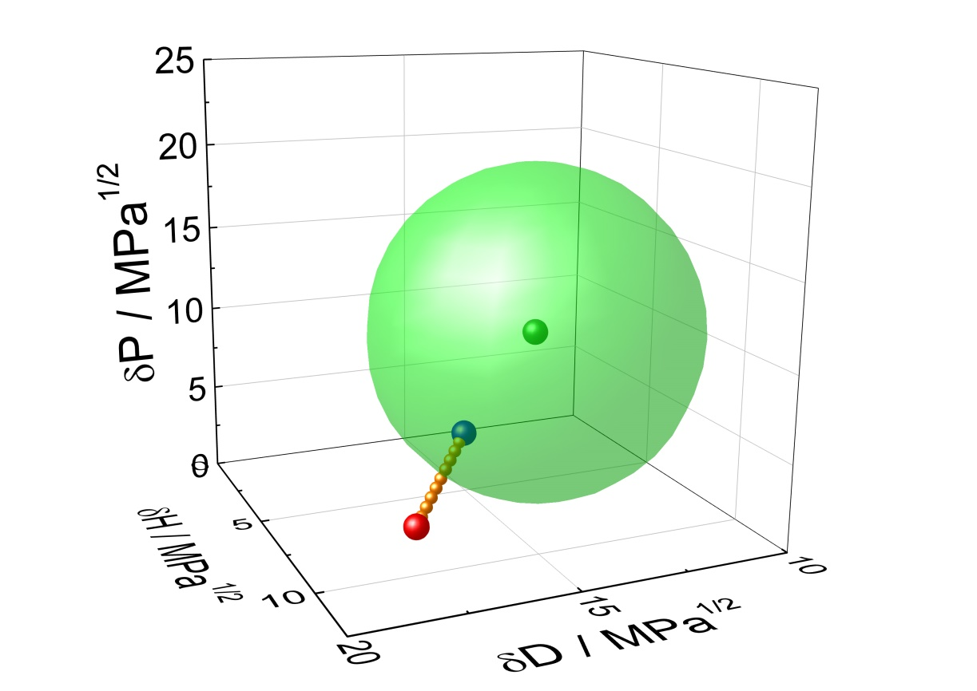
Validation of HSP approach by mixing
“good” and “bad” liquids
100% Ethylacetat
100% 1.4-Dioxane
Tailoring continuous phases regarding dispersibility

Slide 24

Validation by targeted surface decoration of ZnO quantum dots
Synthesis of QD: Acetate molecules on ZnO surface
ZnAc + LiOH
Coordinated acetate
Ligand exchange: Catechol (CAT) molecules on ZnO surface
Reduction of polar
contribution by
larger carbon content
+ benzene ring
Increase of
disperse contribution by carbon backbone
Dispersing procedure for ZnO
- preparation of 0.1 wt.-% ZnO dispersion in different solvents
15 minutes sonication (30 W)
solvents: n-hexane, Toluene, NMP, 1.4-Dioxane, Ethyl acetate, Acetone, Diacetone alcohol, THF, IPA, DMSO, Propylene-1,2-carbonate, MeOH, H₂O, EtOH

Slide 25
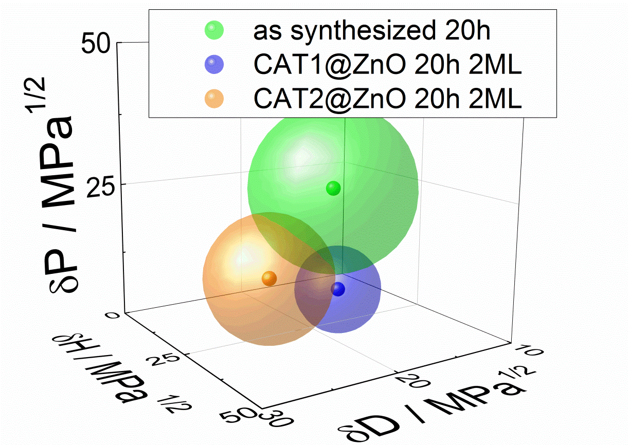
ZnO quantum dots (QD): Influence of surface molecules
 | δD / MPa^{0.5} | δP / MPa^{0.5} | δH / MPa^{0.5} | R / MPa^{0.5}
ZnO 20h 2ML | 15.46 | 23.31 | 15.45 | 15.4
ZnO + Cat1 20h 2ML | 14.61 | 3.17 | 14.51 | 7.9
ZnO + Cat2 20h 2ML | 21.05 | 7.9 | 15.09 | 11.2
Score by
rounding
Decreased δP for ZnO+CAT1 as expected
Increased δD for ZnO+CAT2 as expected

Slide 26
Summary I
1. Sedimentometer equipped with STEP-Technology allows for instrumental in-situ visualization and quantification of particle settling behavior in different liquids.
2. High flexibility due to different wavelengths, light factors, acceleration factors and optical path of sample cells.
3. HTP due to centrifugal acceleration and multisample approach (n = 12).
4. Determination of experimental sedimentation time (ST_{i}) based on integral extinction (SEPView).
5. Calculation of the dimensionless relative sedimentation time (RST_{i}) and normalization by RST_{i}/RST_{max}

Slide 27
Summary II
6. Automatic scoring:
a) Scoring simply by rounding RST_{norm} (< 0.5 good, > 0.5 bad)
(treshold has to be changed to have at least 2, better 3 continuous phases in each score, or use additional liquids)
b) Automatic determination of number of good liquids by determining the minimum of change of the distance of HSP sphere adding consecutively another liquid „ranked“ as good.
7. Entering the automatically good – bad liquids into HSPiP-Software and calculate HSPs by HSPiP-Software
8. Applicability of the instrumental and automatic scoring shown for pigments, Carbon Black and ZnO-QD and validation by mixing good and bad liquids or surface alterations.
9. Attention: HSPs may be altered by dispersion process (type, energy, time). Stay close to the real processing.

Slide 28
Proposal to discuss:
HSP traditional Hansen Solubility Parameter
In case of particles engineers and scientists
are mostly interested in particle dispersibility,
not so much in particle solubility.
To avoid confusion, would it be better to call the parameters
HDP Hansen Dispersibility Parameters ?

Slide 29
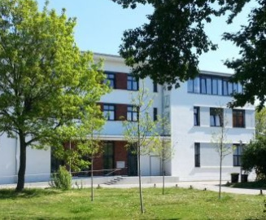

Thank you for your attention!!!
Questions??
Thanks for funding:
Thanks to Prof. Abbott
for HSPiP and help
Thanks to S. van Loon
for Finn Calc M15
More Information: See our booth (Adaptive Systems)
D.Lerche@LUM-GmbH.de, Colin@adaptive.com
www.LUM-GmbH.com,
www.Dispersion-Letters.com

